Slide 1
Tweet Sentiment Analysis

Slide 2
The Big Picture
Problem
Detect the sentiment of a given tweet using machine learning model.
Performance score metrics
Recall, Precision, F1 score

Slide 3
Exploration – the data attributes
Airline sentiment
The label, including 3 classes (Positive, negative and Neutral). Will be used for multiclass classification of the sentiment.
Features will be used
For this assignment i’m going to use (name, text or “the tweet”, user timezone) as machine learning features to predict the sentiment.
Features may be used later to enhance the accuracy
Add (tweet coordinates and tweet created date) to the features, which should enhance the prediction accuracy.

Slide 4
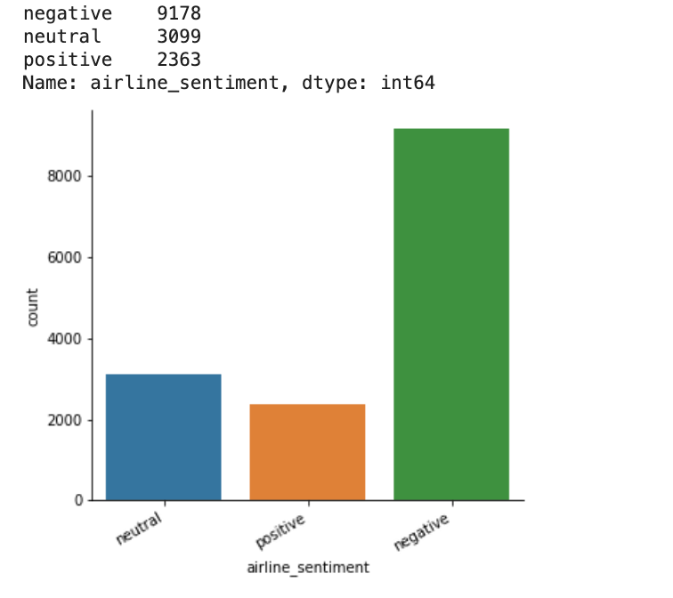
Exploration – Insights
Most of sentiment classes are negative.
Most of tweets come from US & Canada.
Most of tweets come from Boston.

Slide 5
Data Cleansing

